Slide 1



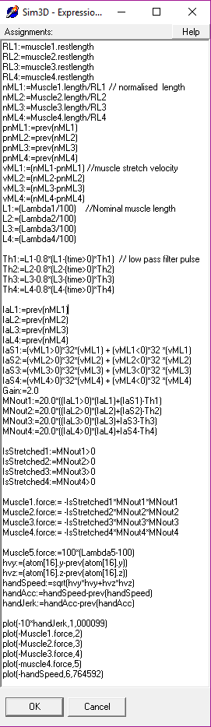
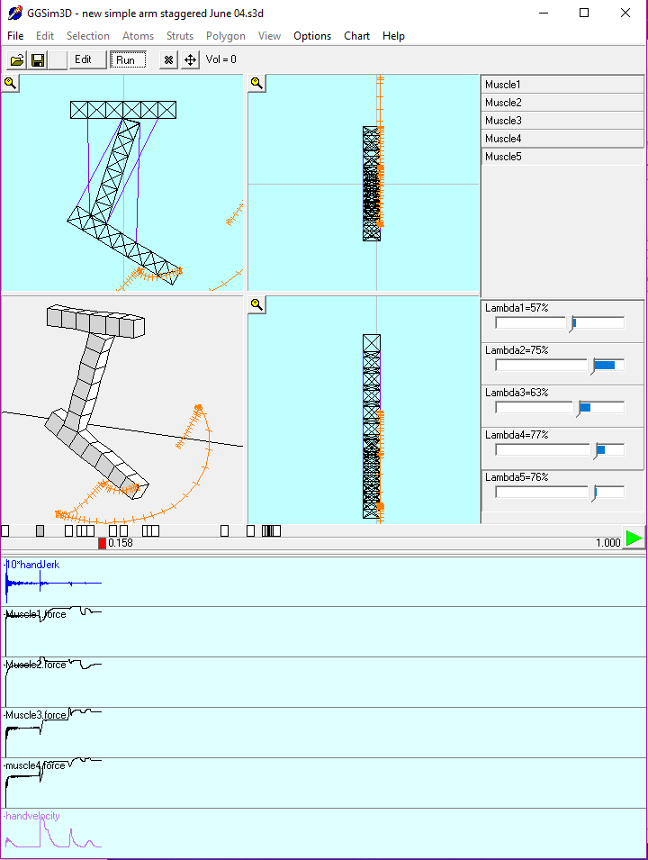
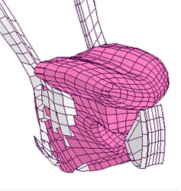
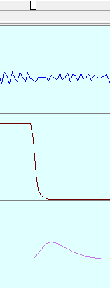
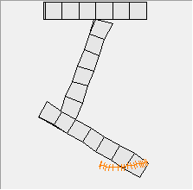
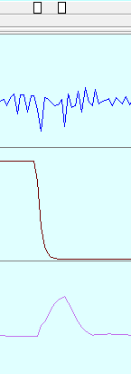
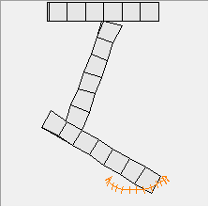
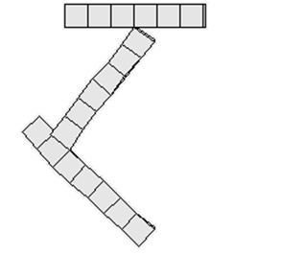
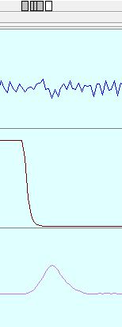

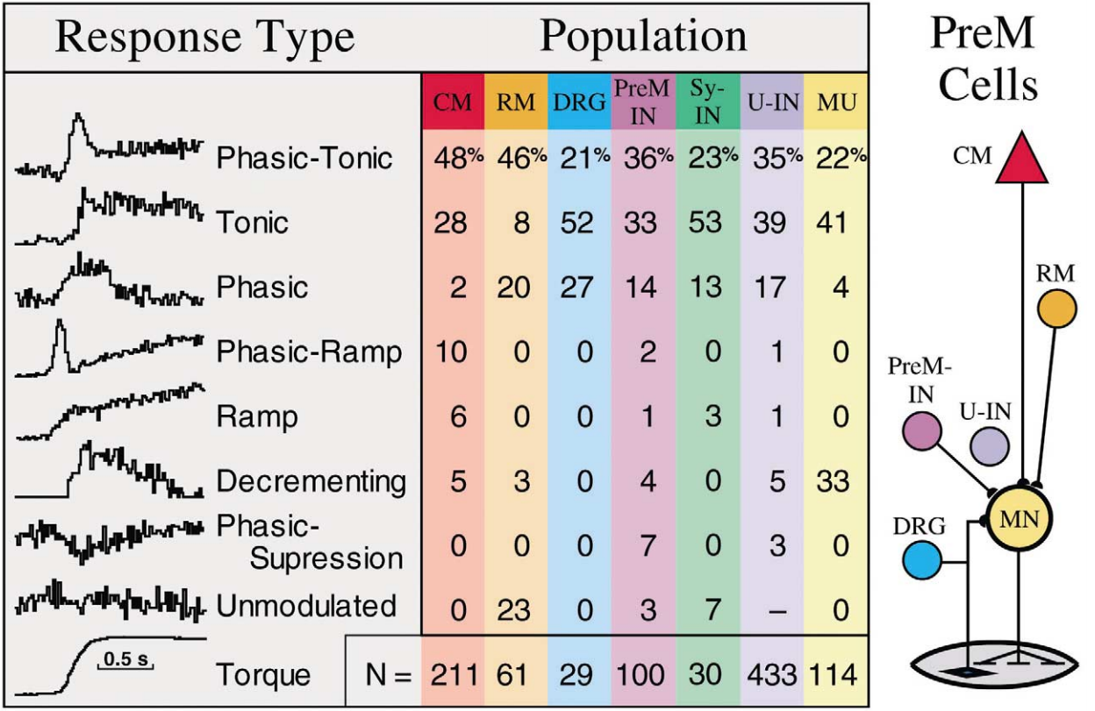
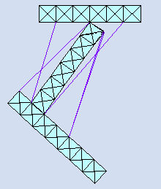
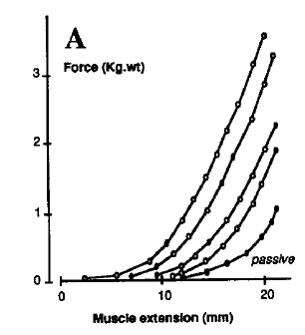
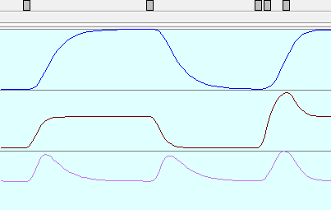
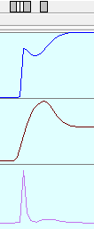
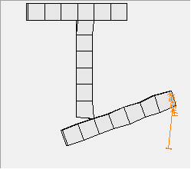
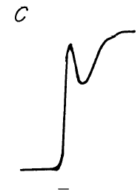
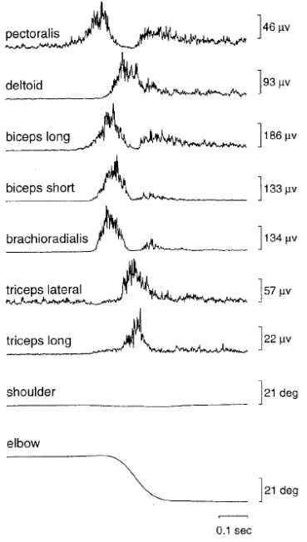



The equilibrium point hypothesis reimagined: Final position control
Supplementary Data
Alan A Wrench and Peter R Balch
@awrench
3D modelling environment
Introduction
Proposal
Method
Biomechanical simulation is based on muscle motoneurons having descending excitation with Ia afferent excitation . λ sets descending excitation level (= nominal muscle length with no load). Afferent Ia stretch feedback (l+Δl) of muscle length (l) and stretch speed (Δl) provide reflexive excitation. where force = (l + Δl - λ) ² l + Δl > λ force = 0 for l + Δl <= λ
Single joint simulation results
Force arm to target and release just after reach is initiated -> arm moving back towards start position before reaching target. This is due to staggered muscle activation.
Discussion
Simulation indicates that a reach can be broken down into an initial pulsed launch towards the target followed by a corrective step to land on the target. The initial pulse generate higher interaction torques which can be mitigated by staging of activation of neuromuscular components of that command. In these simulations the λ commands are staggered as we have not yet developed a spinal network for this purpose.
Conclusion
The single joint simulation is compatible with the result of Bizzi et al 1984. Simulation of single joint and two joint pulse step EP control (i.e. two stage final position control) has not disproved the concept.
We are interested in modelling the articulation of the tongue at the neuromuscular level. We have built an interactive software platform for building 3D biomechanical models. We are pursuing the idea that saccadic eye movement, fast limb movement and lingual speech articulation share a similar neuromuscular control concept. We have built a simple 4-muscle 2-joint limb model to develop and test possible control concepts.
Two joint simulation results
(1). Reach – single equilibrium point (EP) at target
(i.e. pulse EP = Step EP)
(2). Reach – pulse to EP beyond target followed by step to EP at target Joint interaction torques so - target reached via curved path with jerk.
Note : Higher peak velocity and faster deceleration
(3) Same pulse step EP as (2) but staggered activation of each muscle (generated manually by trial and error)
Target reached by straighter path, reduced jerk and bell shaped velocity profile.
Note1: Pattern of muscle delays needed for straight path matches phasic EMG pattern
Note2: Muscle activation order depends on direction.
Note3: Movement velocity control does not require increased stiffness
Hand Jerk
Hand Velocity
Slow deceleration
(Sim3D tongue model)
Hand Jerk
Curved due to interaction torques
1. A reaching gesture consists of two volitional final position instructions,
an initial launch pulse towards a distant equilibrium point that determines velocity and initial direction
optionally followed by another pulse or
a landing step defining the resting target equilibrium point
2. Spinal interneurons stagger the activation of individual muscles, reducing joint interaction torques, jerk, and in doing so, straighten the trajectory of the launch pulse.
3. Timing of the pulse-step transition is controlled to avoid undershoot or overshoot.
4. Curved trajectories occur when launch pulse direction differs from target direction.
Proposals 1 & 2 are investigated here.
Hand Velocity
Intended reach endpoint
Hand speed profile
Hand Jerk
Straighter trajectory
Launch pulse towards initial equilibrium point
Hand Velocity
Bell shaped
Neural response patterns during movement
Step change in equilibrium point acts as a brake
E.E. Fetz et al. / Brain Research Reviews 40 (2002) 53–65
Spinal circuits stagger activation of individual muscles reducing interaction torques
REFS
BIZZI, E., ACCORNERO, N., CHAPPLE, W. and HOGAN, N., 1984. Posture control and trajectory formation during arm movement. Journal of Neuroscience, 4(11), pp. 2738-2744.
Fig. 3. Summary of response patterns in the preferred direction for different populations of neurons during generation of flexion and extension torques at the wrist. Examples of each pattern are illustrated on the left, and schematic of populations on the right. Proportions are given for corticomotoneuronal (CM) [7,8] and rubromotoneuronal cells (RM) [29], premotor afferents in dorsal root ganglia (DRG) [14], spinal premotor interneurons (PreM-IN), spinal unidentified interneurons (U-IN), spinal interneurons with synchrony effects (Sy-IN) and motoneurons (MU; combined data from motor units [35] and motoneurons [27]). Unmodulated U-INs are not included because their proportion could be made arbitrarily large.
Future
We are currently investigating a model based on selection and timing of 2 final position equilibrium points where dynamics of interaction torques are regulated by spinal interneuron circuits. Buhrmann & Di Paolo (2014) describe a similar model where “tuned” spinal circuitry compensates for interaction torques. Their model adheres to EPH tenets where
Descending excitation
Cerebellum–based positional error correction
From Antagonist Renshaw cell (RC)
IN
MN
RC
To Antagonist interneuron (IN)
Pulse-step kinematic specification
λ excitation equivalent to length w/o loads
$$F=k∗({∆l)}^{2}$$
From Antagonist muscle spindle
Ia Afferents (20-40ms latency)
$$\left[\begin{aligned}λ_{1} \\ λ_{2} \\ .. \\ λ_{N}\end{aligned}\right]$$
Cerebellum
Adaptive lookup table or
MAP
of excitory input vs sensory input for prevailing conditions
L = expected stretch learnt from prevailing load conditions
Force-length curves for different voltages (0V,2V,3V,4.5V) of 70Hz square wave (0.1ms pulse duration) of the cerebellar nucleus (cat) i.e. different levels of motor command activity. (Feldman and Orlovsky,1972)
To interneuron (IN) that inhibits antagonist
Inhibitory input
Muscle
Excitatory input
If Ia tonic stretch > expected stretch
tonic stretch
Simple Ia spinal circuit
Corrective excitation
(M2/M3 reflex 50-80ms latency)
e.g. Friedemann et al 1987
central commands comprise of monotonic shifts in equilibrium point that control trajectory and the amount of co-contraction of agonist antagonist pairs controls velocity. Tsianos & Loeb (2014) also describe a spinal circuit model. They train their interneuron network using a cost minimisation based on squared deviation from kinematic target and energy consumed by each muscle. It resulted in phasic muscle activity and straight paths.
Barto,Fagg,Sitkov & Houk (1999) proposed a pulse-step EP model but damping in their model prevented Equilibrium point targets being reached.
We are attempting to determine how the spinal network generates the phasic response.
Torque pulse
Spine
interneurons and motoneurons
?? interneuron threshold settings regulate dynamics matching expected Ia excitation??
Antagonist
Antagonist
Agonist
Agonist
Agonist
Agonist
Ia excitation (M1 reflex 20-40ms Latency)
Y displacement
Y displacement
Angular displacement
from Bizzi et al 1884
interneurons stagger the activation of local agonists and antagonists minimising movement jerk by anticipating stretch reflex.
Flexor λ
Higher velocity
Flexor λ
Ia Afferents
Hand Velocity
Slower acceleration
Faster deceleration
Hand Velocity
Muscles
Expected Internal (antagonistic) and external loads
Unexpected Internal (fatigue/injury) and external loads
time
Notes:
Notes:
In Powerpoint, click View > Guides
Keep text within gutter guides.
Author list: Don’t split names onto two lines (e.g., “Jimmy [break] Smith”). If that happens, use a new line, unless you need the space. Bold the first names of anybody who’s presenting in person.
Intro/methods/result: Do not drop below font size 28, but if you have extra space, jack up the font size until the space is full.
Do not use color in the sidebars except in graphs/figures. It’ll pull attention from the center and slow interpretation for passersby.

